Slide 1
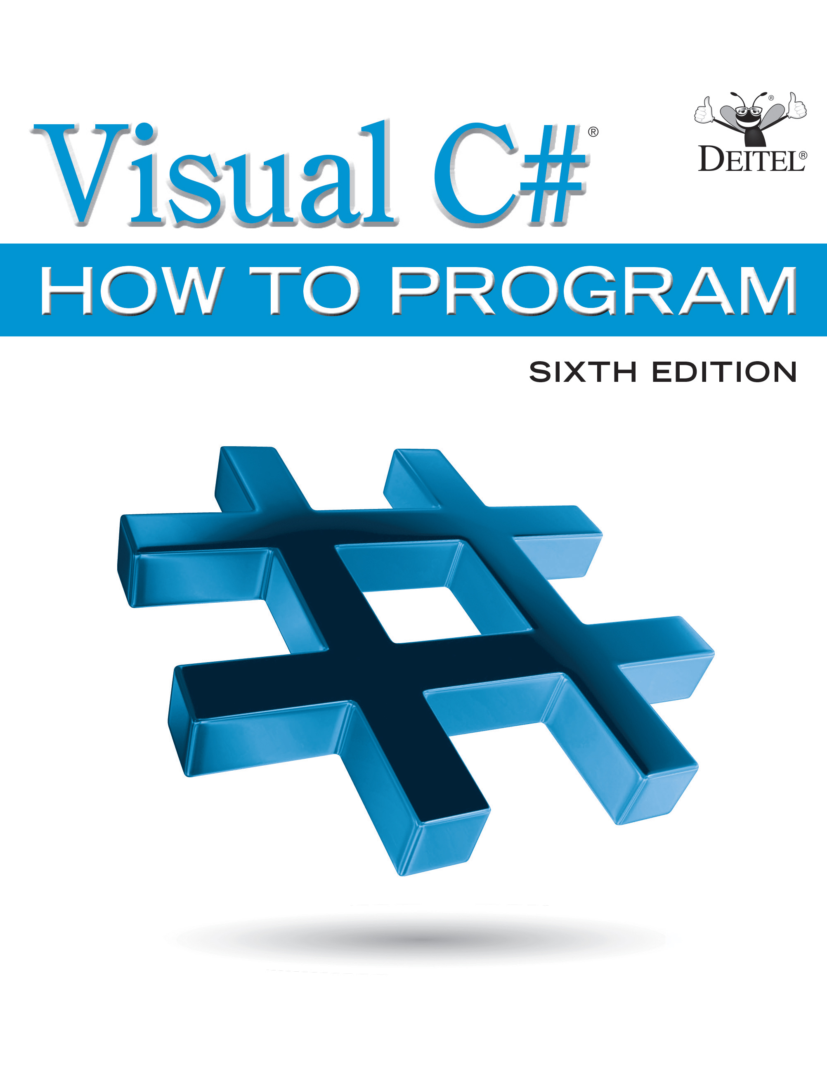
Visual C sharp ® How to Program
Sixth Edition
Chapter 14
Graphical User Interfaces with Windows Forms: Part 1
Copyright © 2017 Pearson Education, Inc. All Rights Reserved
Notes:
If this PowerPoint presentation contains mathematical equations, you may need to check that your computer has the following installed:
1) MathType Plugin
2) Math Player (free versions available)
3) NVDA Reader (free versions available)

Slide 2
Learning Objectives
Design principles of graphical user interfaces (G U I s).
How to create graphical user interfaces.
How to process events in response to user interactions with G U I controls.
The namespaces that contain the classes for G U I controls and event handling.
How to create and manipulate various controls.
How to add descriptive ToolTips to G U I controls.
How to process mouse and keyboard events.

Slide 3
Outline (1 of 3)
14.1 Introduction
14.2 Windows Forms
14.3 Event Handling
14.3.1 A Simple Event-Driven G U I
14.3.2 Auto-Generated G U I Code
14.3.3 Delegates and the Event-Handling Mechanism
14.3.4 Another Way to Create Event Handlers
14.3.5 Locating Event Information

Slide 4
Outline (2 of 3)
14.4 Control Properties and Layout
14.4.1 Anchoring and Docking
14.4.2 Using Visual Studio To Edit a G U I’s Layout
14.5 Labels, TextBoxes and Buttons
14.6 GroupBoxes and Panels
14.7 CheckBoxes and RadioButtons
14.7.1 CheckBoxes
14.7.2 Combining Font Styles with Bitwise Operators
14.7.3 RadioButtons

Slide 5
Outline (3 of 3)
14.8 PictureBoxes
14.9 ToolTips
14.10 NumericUpDown Control
14.11 Mouse-Event Handling
14.12 Keyboard-Event Handling
14.13 Wrap-Up

Slide 6
14.1 Introduction (1 of 2)
A graphical user interface (G U I) allows a user to interact visually with a program.
Figure 14.1 shows a Visual Studio window containing various G U I controls.

Slide 7
Look-and-Feel Observation 14.1
Consistent user interfaces enable a user to learn new apps more quickly because the apps have the same “look” and “feel.”

Slide 8
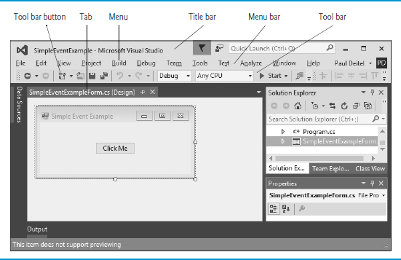
Figure 14.1 G U I Controls in Visual Studio

Slide 9
14.1 Introduction (2 of 2)
G U I controls are objects that can display information on the screen or enable users to interact with an app.
Several common G U I controls are listed in Figure. 14.2.

Slide 10
Figure 14.2 Some Basic G U I Controls
Control | Description
Label | Displays images or uneditable text.
TextBox | Enables the user to enter data via the keyboard. It also can be used to display editable or uneditable text.
Button | Triggers an event when clicked with the mouse.
CheckBox | Specifies an option that can be selected (checked) or unselected (not checked).
ComboBox | Provides a drop-down list of items from which the user can make a selection either by clicking an item in the list or by typing in a box.
ListBox | Provides a list of items from which the user can make a selection by clicking one or more items.
Panel | A container in which controls can be placed and organized.
NumericUpDown | Enables the user to select from a range of numeric input values.

Slide 11
14.2 Windows Forms (1 of 4)
A Form is a graphical element that appears on your computer’s desktop; it can be a dialog, a window or an M D I window.
A component is an instance of a class that implements the IComponent interface, which defines the behaviors that components must implement, such as how the component is loaded.
A control, such as a Button or Label, has a graphical representation at runtime.

Slide 12
14.2 Windows Forms (2 of 4)
Figure 14.3 displays the Windows Forms controls and components from the
Toolbox.
To add a control or component, select it from the Toolbox and drag it onto the Form.

Slide 13
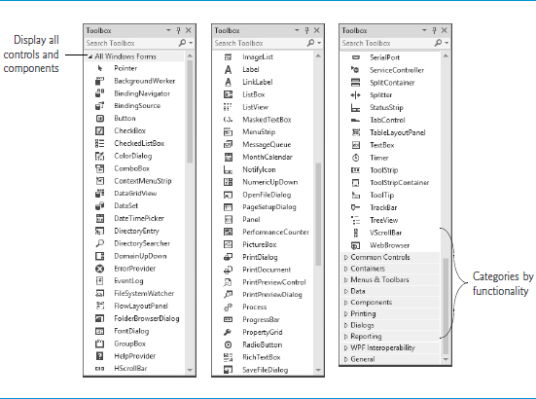
Figure 14.3 Components and Controls for Windows Forms

Slide 14
14.2 Windows Forms (3 of 4)
The active window is the frontmost and has a highlighted title bar.
A window becomes the active window when the user clicks somewhere inside it.
A Form is a container for controls and components.
When you drag items from the Toolbox onto the Form, Visual Studio generates code that creates the object and sets its basic properties.
The I D E maintains the generated code in a separate file using partial classes.

Slide 15
14.2 Windows Forms (4 of 4)
Figure 14.4 lists common Form properties, common methods and a common event.

Slide 16
Figure 14.4 Common Form Properties, Methods and an Event (1 of 2)
Common Properties
Form properties, methods and an event | Description
AcceptButton | Default Button that’s clicked when you press Enter.
AutoScroll | bool value (false by default) that allows or disallows scrollbars when needed.
CancelButton | Button that’s clicked when the Escape key is pressed.
FormBorderStyle | Border style for the Form (Sizable by default).
Font | Font of text displayed on the Form, and the default font for controls added to the Form.
Text | Text in the Form’s title bar.

Slide 17
Figure 14.4 Common Form Properties, Methods and an Event (2 of 2)
Common Methods
Form properties, methods and an event | Description
Close | Closes a Form and releases all resources, such as the memory used for the Form’s contents. A closed Form cannot be reopened.
Hide | Hides a Form, but does not destroy the Form or release its resources.
Show | Displays a hidden Form.
Common Event
Form properties, methods and an event | Description
Load | Occurs before a Form is displayed to the user. You’ll learn about events and event-handling in the next section.

Slide 18
14.3 Event Handling (1 of 11)
G U I s are event driven.
When the user interacts with a G U I component, the event drives the program to perform a task.
A method that performs a task in response to an event is called an event handler.

Slide 19
14.3 Event Handling (2 of 11)
14.3.1 A Simple Event-Driven G U I
The Form in the app of Figure. 14.5 contains a Button that a user can click to display a MessageBox.

Slide 20
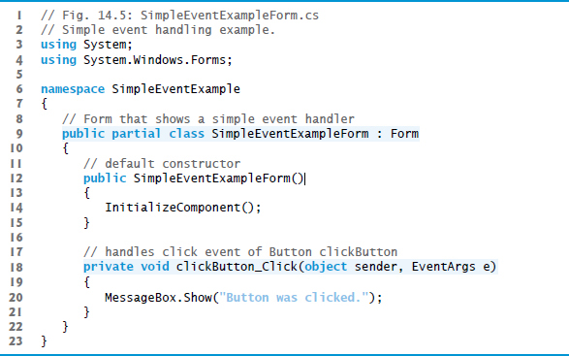
Figure 14.5 Simple Event-Handling Example (1 of 2)

Slide 21
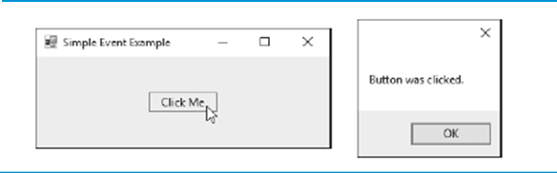
Figure 14.5 Simple Event-Handling Example (2 of 2)

Slide 22
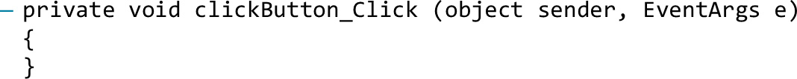
14.3 Event Handling (3 of 11)
Adding an Event Handler for the Button’s Click Event
To create the app’s event handler, double click the Button on the Form.
The following empty event handler is declared:
By convention, the I D E names the event-handler method as

Slide 23
14.3 Event Handling (4 of 11)
Event Handler Parameters
Each event handler receives two parameters when it’s called:
This first—an object reference typically named sender—is a reference to the object that generated the event.
The second is a reference to an EventArgs object (or an object of an EventArgs derived class) which contains additional information about the event.`

Slide 24
14.3 Event Handling (5 of 11)
14.3.2 Auto-Generated G U I Code
Visual Studio places the auto-generated code in the Designer.cs file of the Form.
Open this file by expanding the node in the Solution Explorer window for the file you’re currently working in (SimpleEventExampleForm.cs) and double clicking the file name that ends with Designer.cs.
Since this code (Figures. 14.6 and 14.7) is created and maintained by Visual Studio, you generally don’t need to look at it.

Slide 25
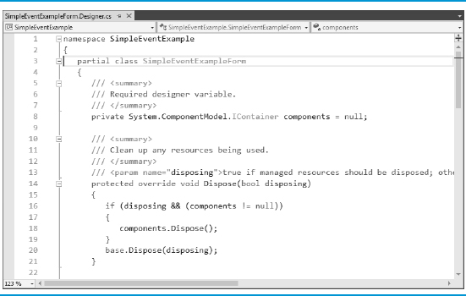
Figure 14.6 First Half of the Visual Studio Generated Code File

Slide 26
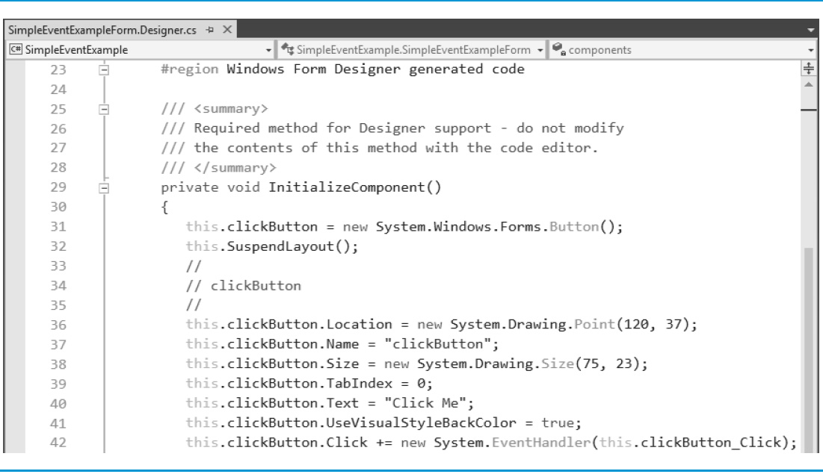
Figure 14.7 Second Half of the Visual Studio Generated Code File (1 of 2)

Slide 27
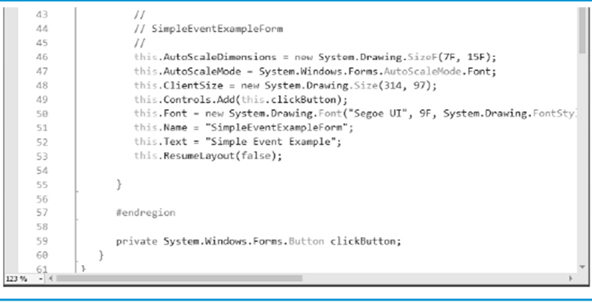
Figure 14.7 Second Half of the Visual Studio Generated Code File (2 of 2)

Slide 28
14.3 Event Handling (6 of 11)
The partial modifier allows the Form’s class to be split among multiple files.
Figure. 14.7 declares the clickButton that we created in Design mode. It’s declared as an instance variable of class SimpleEventExampleForm.
The property values correspond to the values set in the Properties window for each control.
Method InitializeComponent is called when the Form is created.

Slide 29
Error-Prevention Tip 14.1
The code in the Designer.cs file that’s generated by building a G U I in Design mode is not meant to be modified directly, which is why this code is placed in a separate file. Modifying this code can prevent the G U I from being displayed correctly in Design mode and might cause an app to function incorrectly. In Design mode, it’s recommended that you modify control properties only in the Properties window, not in the Designer.cs file.

Slide 30
14.3 Event Handling (7 of 11)
14.3.3 Delegates and the Event-Handling Mechanism
Event handlers are connected to a control’s events via special objects called delegates.
A delegate type declaration specifies the signature of a method—in event handling, the signature specifies the return type and arguments for an event handler.
A delegate of type EventHandler can hold references to methods that return void and receive two parameters—one of type object and one of type EventArgs:
public delegate void EventHandler(object sender, EventArgs e);

Slide 31
14.3 Event Handling (8 of 11)
Indicating the Method that a Delegate Should Call
A Button calls its EventHandler delegate in response to a click.
The delegate’s job is to invoke the appropriate method.
This code is added by Visual Studio when you double click the Button control in Design mode:
Adding more delegates to an event is called multicast delegates.

Slide 32
14.3 Event Handling (9 of 11)
14.3.4 Another Way to Create Event Handlers
Using the Properties Window to Create Event Handlers
Controls can generate many different events.
Clicking the Events icon (the lightning-bolt icon) in the Properties window (Figure. 14.8), displays all the events for the selected control.

Slide 33
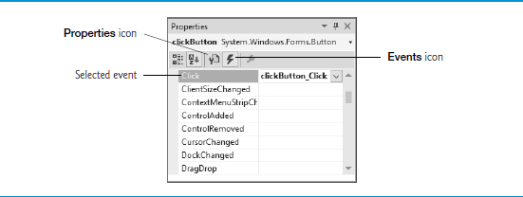
Figure 14.8 Viewing Events for a Button Control in the Properties Window

Slide 34
14.3 Event Handling (10 of 11)
14.3.5 Locating Event Information
Read the Visual Studio documentation to learn about the different events raised by each control.
To do this, select a control in the I D E and press the F1 key to display that control’s online help (Figure. 14.9).
The web page that's displayed contains basic information about the control’s class.

Slide 35
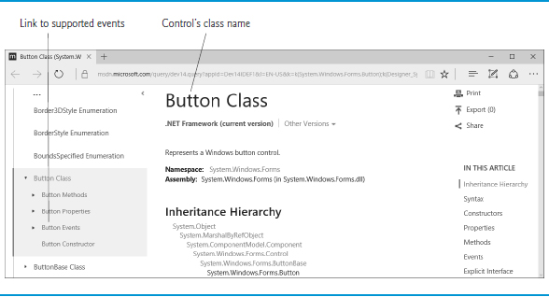
Figure 14.9 Link to List of Button Events

Slide 36
14.3 Event Handling (11 of 11)
Click the name of an event to view its description and examples of its use.
We selected the Click event to display the information in Figure. 14.10.

Slide 37
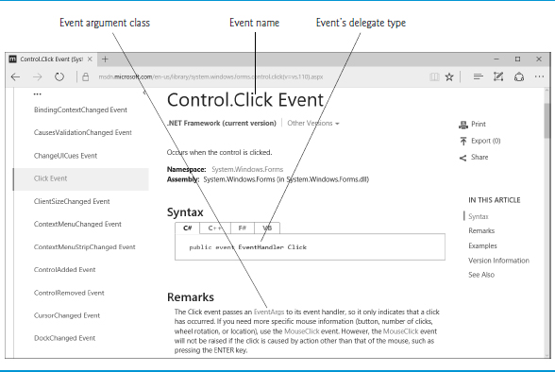
Figure 14.10 Click Event Details

Slide 38
14.4 Control Properties and Layout (1 of 5)
Controls derive from class Control (namespace System.Windows.Forms).
Figure 14.11 lists some of class Control’s properties and methods.

Slide 39
Figure 14.11 Class Control Properties and Methods (1 of 3)
Common Properties
Class Control properties and methods | Description
BackColor | The control’s background color.
BackgroundImage | The control’s background image.
Enabled | Specifies whether the control is enabled (i.e., if the user can interact with it). Typically, portions of a disabled control appear “grayed out” as a visual indication to the user that the control is disabled.
Focused | Indicates whether the control has the focus (only available at runtime).
Font | The Font used to display the control’s text.
ForeColor | The control’s foreground color. This usually determines the color of the text in the Text property.

Slide 40
Figure 14.11 Class Control Properties and Methods (2 of 3)
Class Control properties and methods | Description
TabIndex | The tab order of the control. When the Tab key is pressed, the focus transfers between controls based on the tab order. You can set this order.
TabStop | If true, then a user can give focus to this control via the Tab key.
Text | The text associated with the control. The location and appearance of the text vary depending on the type of control.
Visible | Indicates whether the control is visible.

Slide 41
Figure 14.11 Class Control Properties and Methods (3 of 3)
Common Methods
Class Control properties and methods | Description
Hide | Hides the control (sets the Visible property to false).
Select | Acquires the focus.
Show | Shows the control (sets the Visible property to true).

Slide 42
14.4 Control Properties and Layout (2 of 5)
Anchoring and Docking
Anchoring causes controls to remain at a fixed distance from the sides of the container.
Anchor a control to the right and bottom sides by setting the Anchor property (Figure. 14.12).

Slide 43
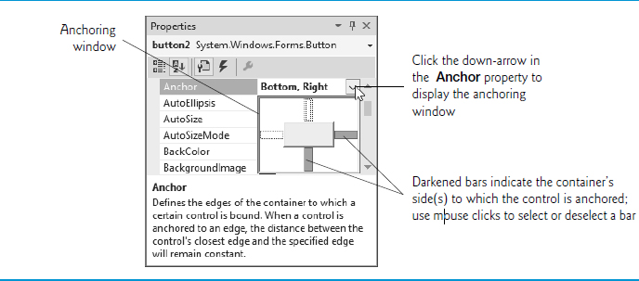
Figure 14.12 Manipulating the Anchor Property of a Control

Slide 44
14.4 Control Properties and Layout (3 of 5)
Execute the app and enlarge the Form (Figure. 14.13).

Slide 45
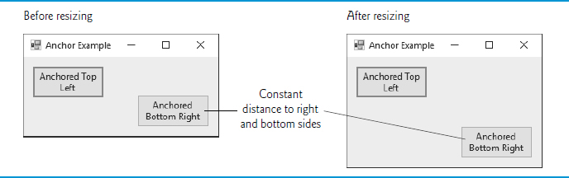
Figure 14.13 Anchoring Demonstration

Slide 46
14.4 Control Properties and Layout (4 of 5)
Docking attaches a control to a container such that the control stretches across an entire side or fills an entire area.
Docking allows a control to span an entire side of its parent container or to fill the entire container (Figure. 14.14).
The Form’s Padding property specifies the distance between the docked controls and the edges.

Slide 47
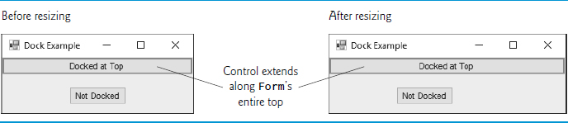
Figure 14.14 Docking a Button to the Top of a Form

Slide 48
Figure 14.15 Control Layout Properties
Control layout properties | Description
Anchor | Causes a control to remain at a fixed distance from the side(s) of the container even when the container is resized.
Dock | Allows a control to span one side of its container or to fill the remaining space in the container.
Padding | Sets the space between a container’s edges and docked controls. The default is 0, causing the control to appear flush with the container’s sides.
Location | Specifies the location (as a set of coordinates) of the upper-left corner of the control, in relation to its container’s upper-left corner.
Size | Specifies the size of the control in pixels as a Size object, which has properties Width and Height.
MinimumSize, MaximumSize | Indicates the minimum and maximum size of a Control, respectively.

Slide 49
14.4 Control Properties and Layout (5 of 5)
Using Visual Studio To Edit a G U I’s Layout
Visual Studio provides tools that help you with G U I layout.
When dragging a control across a Form, blue lines (known as snap lines) help you position the control (Figure. 14.16).
Visual Studio also provides the Format menu, which contains several options for modifying your G U I’s layout.

Slide 50
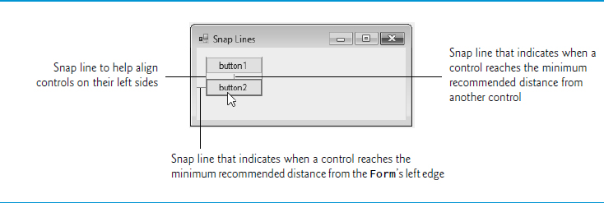
Figure 14.16 Snap Lines for Aligning Controls

Slide 51
14.5 Labels, TextBoxes and Buttons (1 of 5)
Labels display text that the user cannot directly modify.
Figure 14.7 lists common Label properties.

Slide 52
Figure 14.17 Common Label Properties
Common Label properties | Description
Font | The font of the text on the Label.
Text | The text on the Label.
TextAlign | The alignment of the Label’s text on the control—horizontally (left, center or right) and vertically (top, middle or bottom). The default is top, left.

Slide 53
14.5 Labels, TextBoxes and Buttons (2 of 5)
A TextBox (Figure. 14.18) is an area in which either text can be displayed by a program or the user can type text via the keyboard.
If you set the property UseSystemPasswordChar to true, the TextBox becomes a password TextBox.

Slide 54
Figure 14.18 TextBox Properties and an Event (1 of 2)
Common Properties
TextBox properties and an event | Description
AcceptsReturn | If true in a multiline TextBox, pressing Enter in the TextBox creates a new line. If false (the default), pressing Enter is the same as pressing the default Button on the Form. The default Button is the one assigned to a Form’s AcceptButton property.
Multiline | If true, the TextBox can span multiple lines. The default value is false.
ReadOnly | If true, the TextBox has a gray background, and its text cannot be edited. The default value is false.
ScrollBars | For multiline textboxes, this property indicates which scrollbars appear (None—the default, Horizontal, Vertical or Both).

Slide 55
Figure 14.18 TextBox Properties and an Event (2 of 2)
TextBox properties and an event | Description
Text | The TextBox’s text content.
UseSystemPasswordChar | When true, the TextBox becomes a password TextBox, and the systemspecified character masks each character the user types.
Common Event
TextBox properties and an event | Description
TextChanged | Generated when the text changes in a TextBox (i.e., when the user adds or deletes characters). When you double click the TextBox control in Design mode, an empty event handler for this event is generated.

Slide 56
14.5 Labels, TextBoxes and Buttons (3 of 5)
A button is a control that the user clicks to trigger a specific action or to select an option in a program.
A program can use several types of buttons, but all the button classes derive from class ButtonBase.

Slide 57
14.5 Labels, TextBoxes and Buttons (4 of 5)
Figure 14.19 lists common properties and a common eventof class Button.

Slide 58
Figure 14.19 Button Properties and an Event
Common Properties
Button properties and an event | Description
Text | Specifies the text displayed on the Button face.
FlatStyle | Modifies a Button’s appearance—Flat (for the Button to display without a three-dimensional appearance), Popup (for the Button to appear flat until the user moves the mouse pointer over the Button), Standard (three-dimensional) and System, where the Button’s appearance is controlled by the operating system. The default value is Standard.
Common Event
Button properties and an event | Description
Click | Generated when the user clicks the Button. When you double click a Button in design view, an empty event handler for this event is created.

Slide 59
14.5 Labels, TextBoxes and Buttons (5 of 5)
Figure 14.20 uses a TextBox, a Button and a Label.

Slide 60
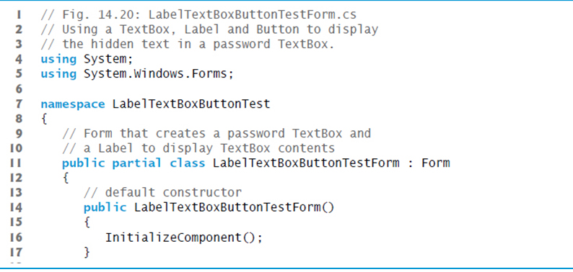
Figure 14.20 Program to Display Hidden Text in a Password Box (1 of 2)

Slide 61
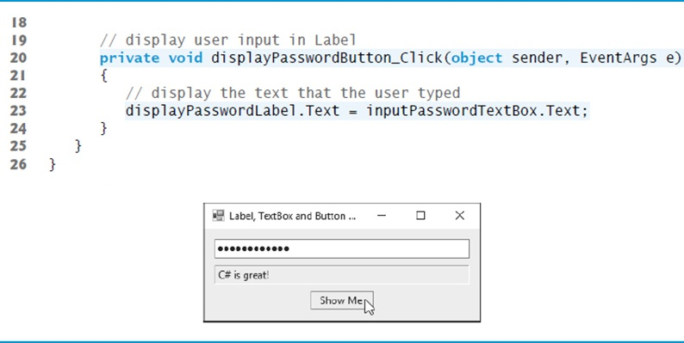
Figure 14.20 Program to Display Hidden Text in a Password Box (2 of 2)

Slide 62
14.6 GroupBoxes and Panels
GroupBoxes and Panels arrange related controls on a G U I.
All of the controls in a GroupBox or Panel move together when the GroupBox or Panel is moved.
The primary difference is that GroupBoxes can display a caption and do not include scrollbars, whereas Panels can include scrollbars and do not include a caption.

Slide 63
Look-and-Feel Observation 14.2
Panels and GroupBoxes can contain other Panels and GroupBoxes for more complex layouts.

Slide 64
Figure 14.21 GroupBox Properties
GroupBox properties | Description
Controls | The set of controls that the GroupBox contains.
Text | Specifies the caption text displayed at the top of the GroupBox.

Slide 65
Figure 14.22 Panel Properties
Panel properties | Description
AutoScroll | Indicates whether scrollbars appear when the Panel is too small to display all of its controls. The default value is false.
BorderStyle | Sets the border of the Panel. The default value is None; other options are Fixed3D and FixedSingle.
Controls | The set of controls that the Panel contains.

Slide 66
Look-and-Feel Observation 14.3
You can organize a G U I by anchoring and docking controls inside a GroupBox or Panel. The GroupBox or Panel then can be anchored or docked inside a Form. This divides controls into functional “groups” that can be arranged easily.

Slide 67
14.6 GroupBoxes and Panels (1 of 2)
To create a GroupBox or Panel, drag its icon from the Toolbox onto a Form.
Then, drag new controls from the Toolbox directly into the GroupBox or Panel.
To enable the scrollbars, set the Panel’s AutoScroll property to true.
If the Panel cannot display all of its controls, scrollbars appear (Figure. 14.23).

Slide 68
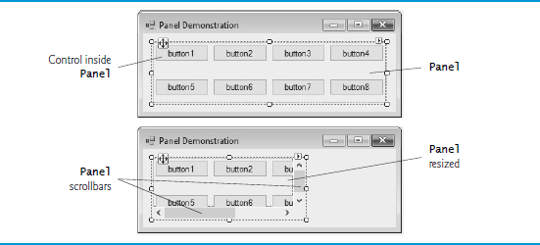
Figure 14.23 Creating a Panel with Scrollbars

Slide 69
14.6 GroupBoxes and Panels (2 of 2)
The program in Figure. 14.24 uses a GroupBox and a Panel to arrange Buttons.

Slide 70
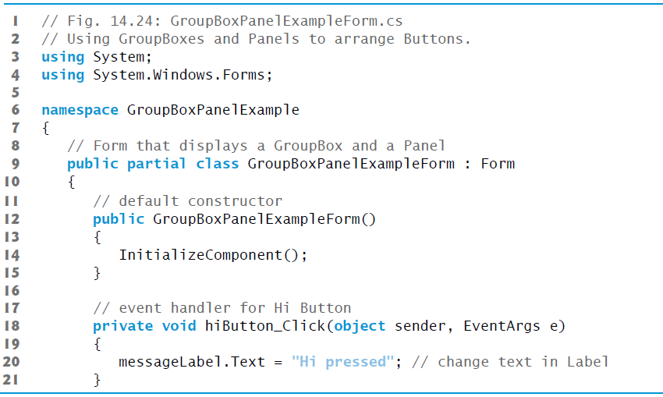
Figure 14.24 Using GroupBoxes and Panels to Arrange Buttons (1 of 3)

Slide 71
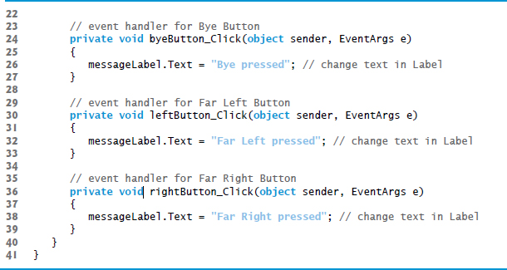
Figure 14.24 Using GroupBoxes and Panels to Arrange Buttons (2 of 3)

Slide 72
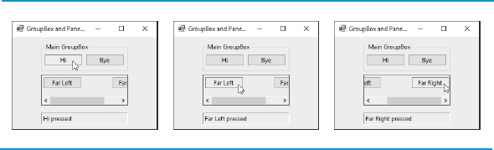
Figure 14.24 Using GroupBoxes and Panels to Arrange Buttons (3 of 3)

Slide 73
14.7 CheckBoxes and RadioButtons
CheckBoxes
A CheckBox is a small square that either is blank or contains a check mark.
You can also configure a CheckBox to toggle between three states by setting its Three­State property to True.
Any number of CheckBoxes can be selected at a time.

Slide 74
Figure 14.25 CheckBox Properties and an Event (1 of 2)
Common Properties
CheckBox properties and an event | Description
Appearance | By default, this property is set to Normal, and the CheckBox displays as a traditional checkbox. If it’s set to Button, the CheckBox displays as a Button that looks pressed when the CheckBox is checked.
Checked | Indicates whether the CheckBox is checked (contains a check mark) or unchecked (blank). This property returns a bool value. The default is false (unchecked).
CheckState | Indicates whether the CheckBox is checked or unchecked with a value from the CheckState enumeration (Checked, Unchecked or Indeterminate). Indeterminate is used when it’s unclear whether the state should be Checked or Unchecked. When CheckState is set to Indeterminate, the CheckBox is usually shaded.

Slide 75
Figure 14.25 CheckBox Properties and an Event (2 of 2)
Common Event
CheckBox properties and an event | Description
Text | Specifies the text displayed to the right of the CheckBox.
ThreeState | When this property is true, the CheckBox has three states—checked, unchecked and indeterminate. By default, this property is false and the CheckBox has only two states—checked and unchecked. When true, Checked returns true for both the checked and indeterminate states.
CheckedChanged | Generated any time the Checked or CheckState property changes. This is a CheckBox’s default event. When a user double clicks the CheckBox control in design view, an empty event handler for this event is generated.

Slide 76
14.7 CheckBoxes and RadioButtons (1 of 4)
The program in Figure. 14.26 allows the user to select CheckBoxes to change a Label’s font style.

Slide 77
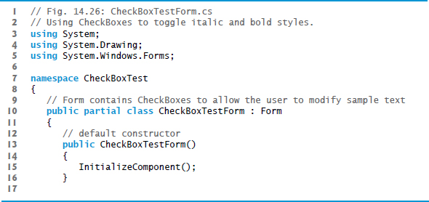
Figure 14.26 Using CheckBoxes to Toggle Italic and Bold Styles (1 of 3)

Slide 78
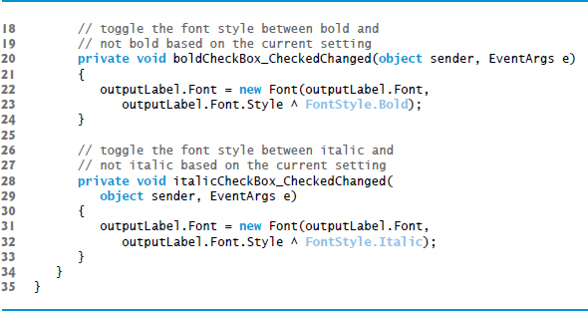
Figure 14.26 Using CheckBoxes to Toggle Italic and Bold Styles (2 of 3)

Slide 79
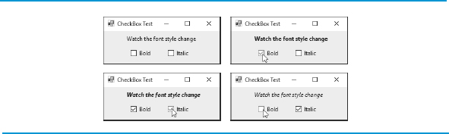
Figure 14.26 Using CheckBoxes to Toggle Italic and Bold Styles (3 of 3)

Slide 80
14.7 CheckBoxes and RadioButtons (2 of 4)
To change the font style on a Label, you must set its Font property to a new Font object.
The Font constructor we used takes the current font and the new style as arguments.
Combining Font Styles with Bitwise Operators
Styles can be combined via bitwise operators—operators that perform manipulation on bits of information.
We needed to set the FontStyle so that the text appears in bold if it was not bold originally, and vice versa
The logical exclusive OR operator makes toggling the text style simple.

Slide 81
14.7 CheckBoxes and RadioButtons (3 of 4)
RadioButtons
Radio buttons are similar to CheckBoxes in that they also have two states—selected and not selected.
RadioButtons normally appear as a group, in which only one RadioButton can be selected at a time.
All RadioButtons added to a container become part of the same group.

Slide 82
Look-and-Feel Observation 14.4
Use RadioButtons when the user should choose only one option in a group. Use CheckBoxes when the user should be able to choose multiple options in a group.

Slide 83
Figure 14.27 RadioButton Properties and an Event
Common Properties
RadioButton properties and an event | Description
Checked | Indicates whether the RadioButton is checked.
Text | Specifies the RadioButton’s text.
Common Event
RadioButton properties and an event | Description
CheckedChanged | Generated every time the RadioButton is checked or unchecked. When you double click a RadioButton control in design view, an empty event handler for this event is generated.

Slide 84
Software Engineering Observation 14.1
Forms, GroupBoxes, and Panels can act as logical groups for RadioButtons. The RadioButtons within each group are mutually exclusive to each other, but not to RadioButtons in different logical groups.

Slide 85
14.7 CheckBoxes and RadioButtons (4 of 4)
The program in Figure. 14.28 uses RadioButtons to enable users to select options for a MessageBox.

Slide 86
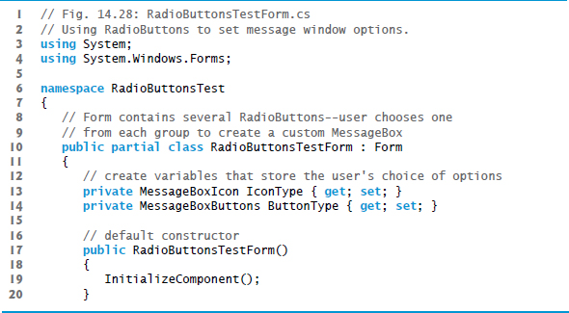
Figure 14.28 Using RadioButtons to Set Message-Window Options (1 of 10)

Slide 87
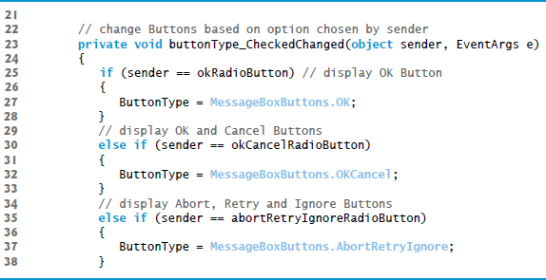
Figure 14.28 Using RadioButtons to Set Message-Window Options (2 of 10)

Slide 88
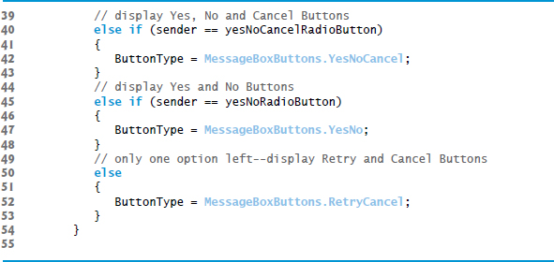
Figure 14.28 Using RadioButtons to Set Message-Window Options (3 of 10)

Slide 89
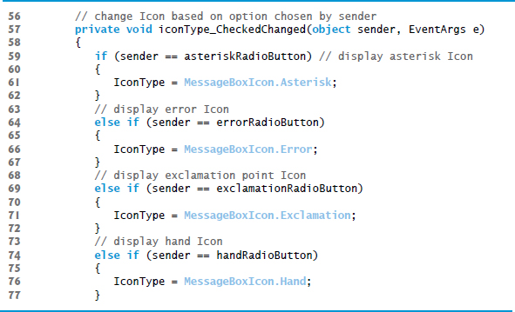
Figure 14.28 Using RadioButtons to Set Message-Window Options (4 of 10)

Slide 90
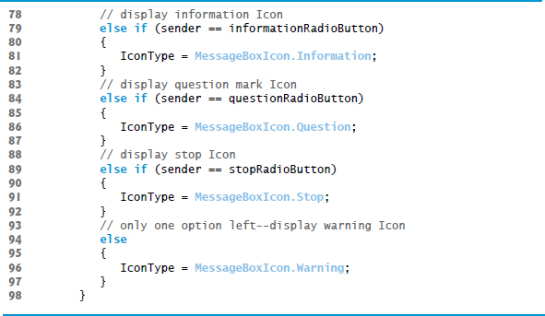
Figure 14.28 Using RadioButtons to Set Message-Window Options (5 of 10)

Slide 91
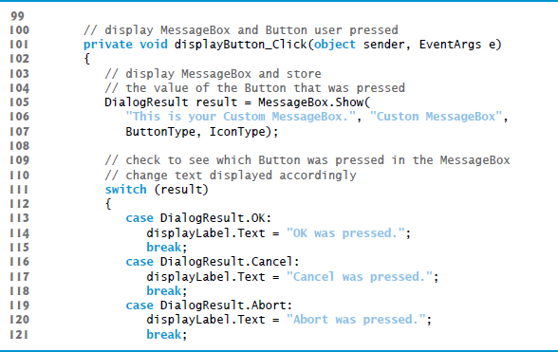
Figure 14.28 Using RadioButtons to Set Message-Window Options (6 of 10)

Slide 92
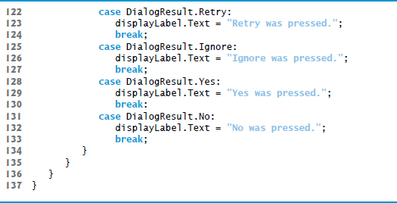
Figure 14.28 Using RadioButtons to Set Message-Window Options (7 of 10)

Slide 93
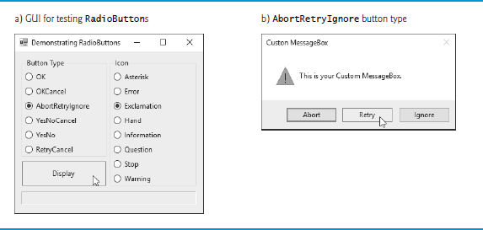
Figure 14.28 Using RadioButtons to Set Message-Window Options (8 of 10)

Slide 94
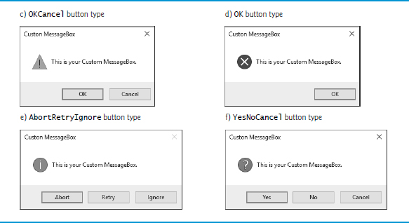
Figure 14.28 Using RadioButtons to Set Message-Window Options (9 of 10)

Slide 95
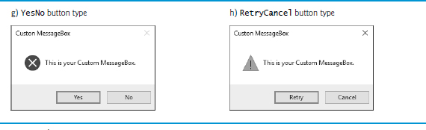
Figure 14.28 Using RadioButtons to Set Message-Window Options (10 of 10)

Slide 96
14.8 PictureBoxes (1 of 4)
A PictureBox displays an image.
Figure 14.29 describes common PictureBox properties and a common event.

Slide 97
Figure 14.29 PictureBox Properties and an Event (1 of 2)
Common Properties
PictureBox properties and an event | Description
Image | Sets the image to display in the PictureBox.
SizeMode | Controls image sizing and positioning. Values are Normal (default), StretchImage, AutoSize, CenterImage and Zoom. Normal places the image in the PictureBox’s top-left corner, and CenterImage puts the image in the middle. Both truncate the image if it’s too large. StretchImage fits the image in the PictureBox. AutoSize resizes the PictureBox to fit the image. Zoom resizes the image to to fit the PictureBox but maintains the original aspect ratio.

Slide 98
Figure 14.29 PictureBox Properties and an Event (2 of 2)
Common Event
PictureBox properties and an event | Description
Click | Occurs when the user clicks a control. When you double click this control in the designer, an event handler is generated for this event.

Slide 99
14.8 PictureBoxes (2 of 4)
Figure 14.30 uses a PictureBox to display bitmap images.

Slide 100
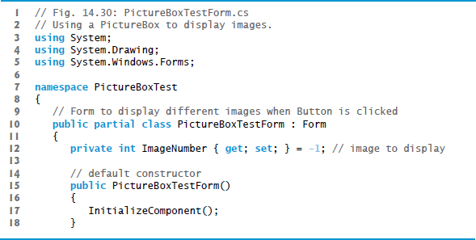
Figure 14.30 Using a PictureBox to Display Images (1 of 3)

Slide 101
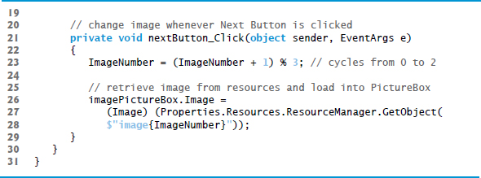
Figure 14.30 Using a PictureBox to Display Images (2 of 3)

Slide 102
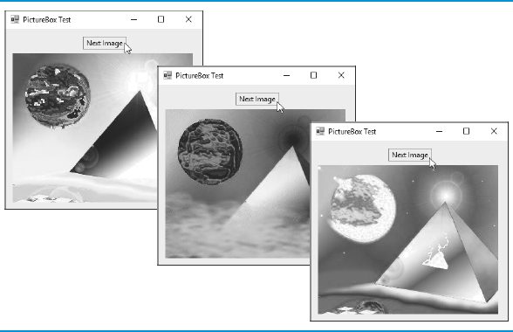
Figure 14.30 Using a PictureBox to Display Images (3 of 3)

Slide 103
14.8 PictureBoxes (3 of 4)
Using Resources Programmatically
Embedding the images in the app prevents problems of using several separate files.
To add a resource:
Double click the project’s Properties node in the Solution Explorer.
Click the Resources tab.
At the top of the Resources tab click the down arrow next to the Add Resource button and select Add Existing File…
Locate the files you wish to add and click the Open button.
Save your project.

Slide 104
14.8 PictureBoxes (4 of 4)
A project’s resources are stored in its Resources class.
Its ResourceManager object allows interacting with the resources programmatically.
To access an image, use the method GetObject, which takes as an argument the resource name as it appears in the Resources tab.
The Resources class also provides direct access with expressions of the form Resources.resourceName.

Slide 105
14.9 ToolTips (1 of 4)
Recall that tool tips are the helpful text that appears when the mouse hovers over an item in a G U I.
Figure 14.31 describes common properties and a common event of class ToolTip.

Slide 106
Figure 14.31 ToolTip Properties and an Event
Common Properties
ToolTip properties and an event | Description
AutoPopDelay | The amount of time (in milliseconds) that the tool tip appears while the mouse is over a control.
InitialDelay | The amount of time (in milliseconds) that a mouse must hover over a control before a tool tip appears.
ReshowDelay | The amount of time (in milliseconds) between which two different tool tips appear (when the mouse is moved from one control to another).
Common Event
ToolTip properties and an event | Description
Draw | Raised when the tool tip is about to be displayed. This event allows programmers to modify the appearance of the tool tip.

Slide 107
14.9 ToolTips (2 of 4)
A ToolTip component appears in the component tray—the region below the Form in Design mode.
A ToolTip on property for each ToolTip component appears in the Properties window for the Form’s other controls.
Figure 14.32 demonstrates the ToolTip component.

Slide 108
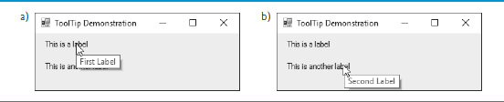
Figure 14.32 Demonstrating the ToolTip Component

Slide 109
14.9 ToolTips (3 of 4)
Figure 14.33 shows the ToolTip in the component tray.
We set the tool tip text for the first Label to "First Label" and the tool tip text for the second Label to "Second Label".

Slide 110
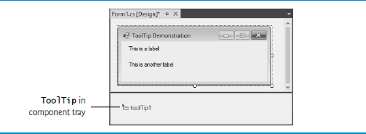
Figure 14.33 Demonstrating the Component Tray

Slide 111
14.9 ToolTips (4 of 4)
Figure 14.34 demonstrates setting the tool-tip text for the first Label.

Slide 112
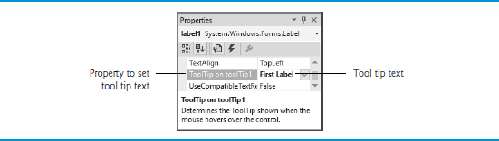
Figure 14.34 Setting a Control's Tool Tip Text

Slide 113
14.10 NumericUpDown Control (1 of 2)
Restricting a user’s input choices to a specific range of numeric values can be done with a NumericUpDown control.
A user can type numeric values into this control or click up and down arrows.
Figure 14.35 describes common NumericUpDown properties and an event.

Slide 114
Figure 14.35 NumericUpDown Properties and an Event (1 of 2)
Common Properties
NumericUpDown properties and an event | Description
DecimalPlaces | Specifies how many decimal places to display in the control.
Increment | Specifies by how much the current number in the control changes when the user clicks the control’s up and down arrows.
Maximum | Largest value in the control’s range.
Minimum | Smallest value in the control’s range.
UpDownAlign | Modifies the alignment of the up and down Buttons on the NumericUpDown control. This property can be used to display these Buttons either to the left or to the right of the control.
Value | The numeric value currently displayed in the control.

Slide 115
Figure 14.35 NumericUpDown Properties and an Event (2 of 2)
Common Event
NumericUpDown properties and an event | Description
ValueChanged | This event is raised when the value in the control is changed. This is the default event for the NumericUpDown control.

Slide 116
14.10 NumericUpDown Control (2 of 2)
Figure 14.36 demonstrates a NumericUpDown control in a G U I app that calculates interest rate.
For the NumericUpDown control, we set the Minimum to 1 and the Maximum to 10.
We set the NumericUpDown’s ReadOnly property to true to indicate that the user cannot type a number into the control.

Slide 117
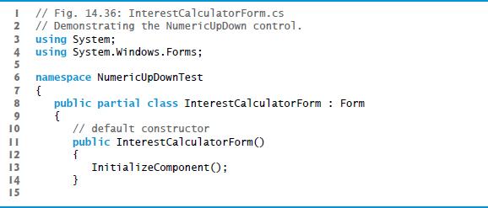
Figure 14.36 Demonstrating the NumericUpDown Control (1 of 3)

Slide 118
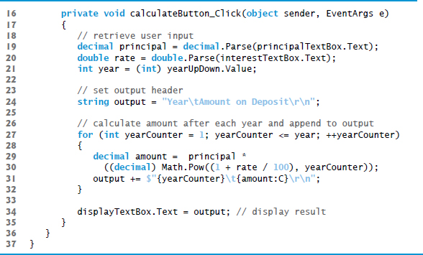
Figure 14.36 Demonstrating the NumericUpDown Control (2 of 3)

Slide 119
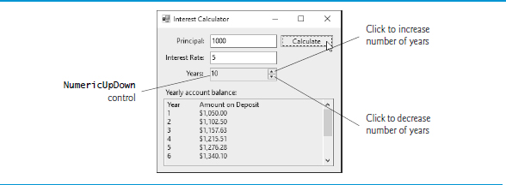
Figure 14.36 Demonstrating the NumericUpDown Control (3 of 3)

Slide 120
14.11 Mouse-Event Handling (1 of 3)
Mouse events are generated when the user interacts with a control via the mouse.
Information about the event is passed through a MouseEvent­Args object, and the delegate type is MouseEventHandler.
MouseEventArgs x- and y-coordinates are relative to the control that generated the event.
Several common mouse events and event arguments are described in Figure 14.37.

Slide 121
Figure 14.37 Mouse Events and Event Arguments (1 of 2)
Mouse Events with Event Argument of Type EventArgs
MouseEnter | Mouse cursor enters the control’s boundaries.
MouseHover | Mouse cursor hovers within the control’s boundaries.
MouseLeave | Mouse cursor leaves the control’s boundaries.
Mouse Events with Event Argument of Type MouseEventArgs
MouseDown | Mouse button is pressed while the mouse cursor is within a control’s boundaries.
MouseMove | Mouse cursor is moved while in the control’s boundaries.
MouseUp | Mouse button is released when the cursor is over the control’s boundaries.
MouseWheel | Mouse wheel is moved while the control has the focus.

Slide 122
Figure 14.37 Mouse Events and Event Arguments (2 of 2)
Class MouseEventArgs Properties
Button | Specifies which mouse button was pressed (Left, Right, Middle or None).
Clicks | The number of times that the mouse button was clicked.
X | The x-coordinate within the control where the event occurred.
Y | The y-coordinate within the control where the event occurred.

Slide 123
14.11 Mouse-Event Handling (2 of 3)
Figure 14.38 uses mouse events to draw on a Form.

Slide 124
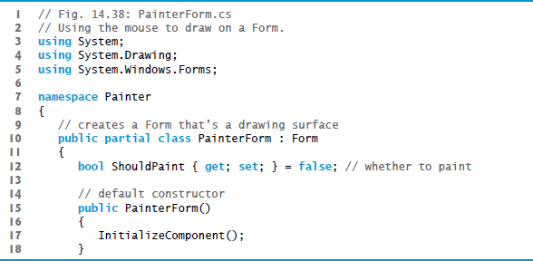
Figure 14.38 Using the Mouse to Draw on a Form (1 of 4)

Slide 125
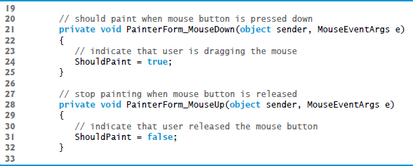
Figure 14.38 Using the Mouse to Draw on a Form (2 of 4)

Slide 126
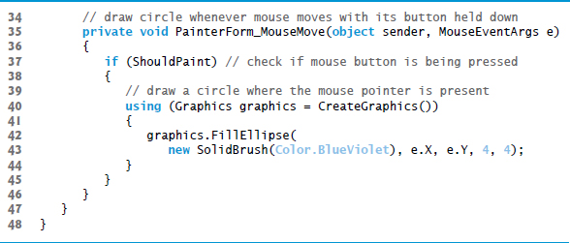
Figure 14.38 Using the Mouse to Draw on a Form (3 of 4)

Slide 127
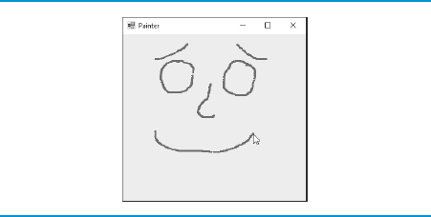
Figure 14.38 Using the Mouse to Draw on a Form (4 of 4)

Slide 128
14.11 Mouse-Event Handling (3 of 3)
Recall from Chapter 13 that the using statement automatically calls Dispose on the object that was created in the parentheses following keyword using.
This is important because Graphics objects are a limited resource.
Calling Dispose on a Graphics object ensures that its resources are returned to the system for reuse.

Slide 129
14.12 Keyboard-Event Handling
There are three key events:
The KeyPress event occurs when the user presses a key that represents an ASCII character.
The KeyPress event does not indicate whether modifier keys (e.g., Shift, Alt and Ctrl) were pressed; if this information is important, the KeyUp or KeyDown events can be used.

Slide 130
Figure 14.39 Keyboard Events and Event Arguments (1 of 2)
Key Events with Event Arguments of Type KeyEventArgs
KeyDown | Generated when a key is initially pressed.
KeyUp | Generated when a key is released.
Key Event with Event Argument of Type KeyPressEventArgs
KeyPress | Generated when a key is pressed. Raised after KeyDown and before KeyUp.
Class KeyPressEventArgs Properties
KeyChar | Returns the A S C I I character for the key pressed.
Class KeyEventArgs Properties
Alt | Indicates whether the Alt key was pressed.
Control | Indicates whether the Ctrl key was pressed.
Shift | Indicates whether the Shift key was pressed.

Slide 131
Figure 14.39 Keyboard Events and Event Arguments (2 of 2)
KeyCode | Returns the key code for the key as a value from the Keys enumeration. This does not include modifier-key information. It’s used to test for a specific key.
KeyData | Returns the key code for a key combined with modifier information as a Keys value. This property contains all information about the pressed key.
KeyValue | Returns the key code as an int, rather than as a value from the Keys enumeration. This property is used to obtain a numeric representation of the pressed key. The int value is known as a Windows virtual key code.
Modifiers | Returns a Keys value indicating any pressed modifier keys (Alt, Ctrl and Shift). This property is used to determine modifier-key information only.

Slide 132
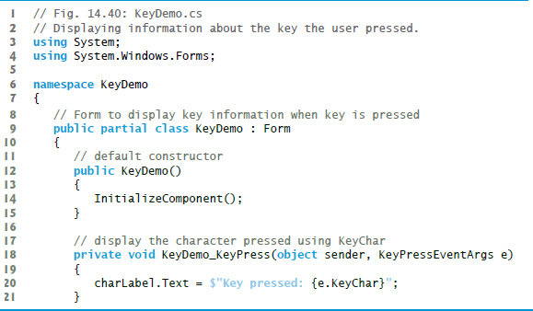
Figure 14.40 Displaying Information About the Key the User Pressed (1 of 4)

Slide 133
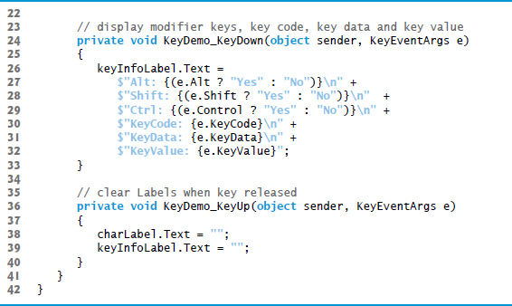
Figure 14.40 Displaying Information About the Key the User Pressed (2 of 4)

Slide 134

Figure 14.40 Displaying Information About the Key the User Pressed (3 of 4)

Slide 135

Figure 14.40 Displaying Information About the Key the User Pressed (4 of 4)

Slide 136
Software Engineering Observation 14.2
To cause a control to react when a particular key is pressed (such as Enter), handle a key event and test for the pressed key. To cause a Button to be clicked when the Enter key is pressed on a Form, set the Form’s AcceptButton property.

Slide 137

Copyright

